Slide 1

Credit Score Classification Analysis
A Machine Learning Approach to Predicting Creditworthiness
Presented by: Tran Ngoc Huy

Slide 2

Chapter 1: The Challenge
Automating Credit Risk Assessment
The Problem
Our Objective
Financial institutions require a reliable and automated system to quickly assess the credit risk of loan applicants. Manual assessment is slow, prone to inconsistency, and costly.
To build and evaluate several machine learning models to accurately classify an individual's creditworthiness and identify the key factors that drive credit scores.
The analysis leverages the "Credit Score Classification" dataset from Kaggle: https://www.kaggle.com/datasets/iremnurtokuroglu/credit-score-classification-cleaned-dataset/data

Slide 3
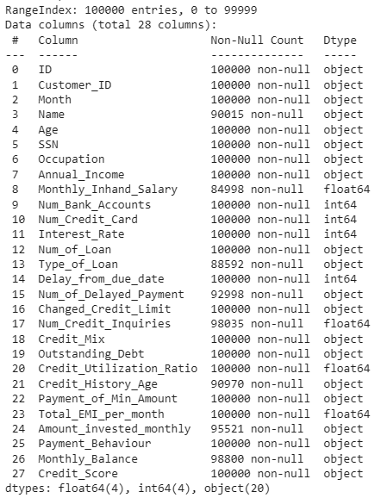
Chapter 2: Dataset Overview
Dataset Overview
A first look at our dataset reveals its structure
Features & Target
A mix of numerical data (like Age, Annual_Income, Num_of_Loan) and categorical data (like Occupation, Credit_Mix). The target variable, Credit_Score, our prediction goal, is categorized into 'Good', 'Standard', or 'Poor'.
Dataset Size
The dataset contains 100,000 entries, providing a solid foundation for robust analysis and model training.

Slide 4
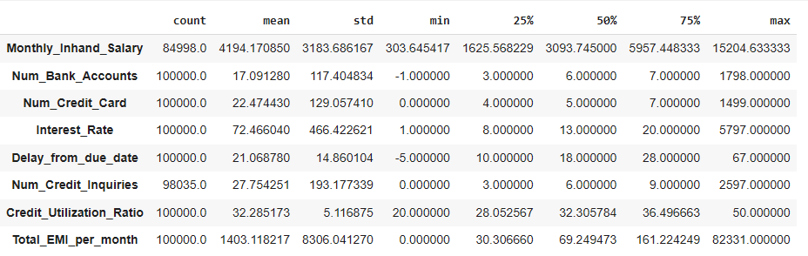
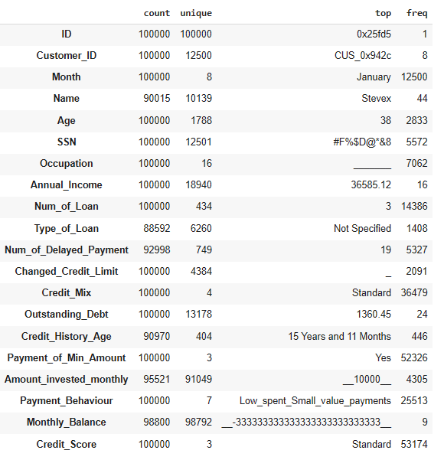
It begins with preprocessing, which converts "bad" inputs into missing markers ($NaN$) and ensures the column's data type is numeric. Next, it identifies and converts outliers (including negative values) to $NaN$ if they fall outside a safe range determined by group-level frequency data. Finally, all missing values are filled using a two-step imputation: prioritizing the local group mode for contextual accuracy, and then using the overall median as a final, global fallback to ensure the column is fully populated and clean.
Data Quality Assurance
Before analysis, we ensured the data was clean and reliable
Missing Values
- Converts "bad" inputs into missing markers (NaN) and ensures the column's data type is numeric.
- Identifies and converts outliers (including negative values) to NaN if they fall outside a safe range determined by group-level frequency data.
- All missing values are filled using a two-step imputation: prioritizing the local group mode for contextual accuracy, and then using the overall median as a final, global fallback to ensure the column is fully populated and clean.
No Duplicate Records
We verified that there were no
duplicate rows in the dataset

Slide 5
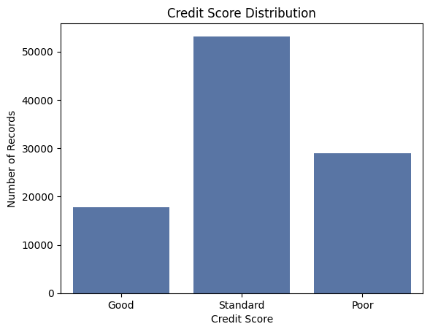
Target Variable - A Balanced View
We analyzed the distribution of our target variable, Credit_Score
Number of Unique Values: 3
Distribution of column: Credit_Score
Standard 53,174
Poor 28,998
Good 17,828
Observation
Implication
The 3 categories ('Good', 'Standard', 'Poor') are fairly balanced.
This is excellent for model training, as it prevents the model from being biased towards any single class.

Slide 6
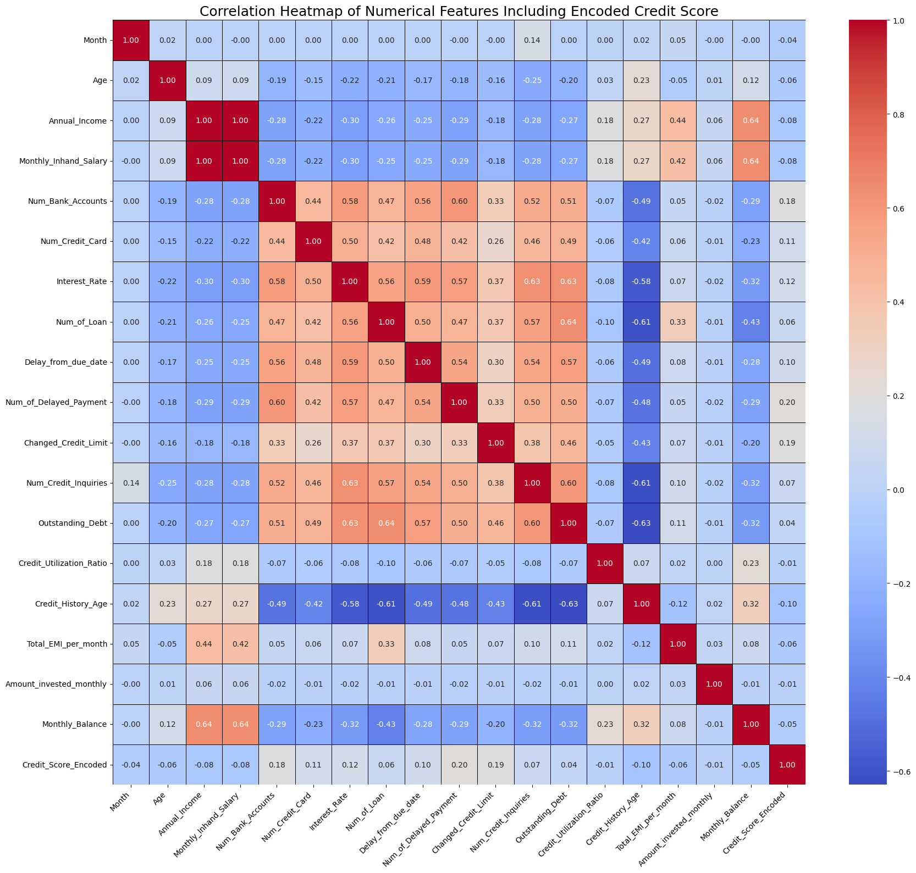
Data Correlation
We analyzed the correlation of our data
We encode our target variable Credit_score as follow:
0 is Good
1 is Standard
2 is Poor
Observation
Observation
The feature that has good correlation with ‘Poor” credit score
Are Num_of Delayed_Payment, Change_Credit_limit,
Num_Bank_accounts, Interest_rate and Num_credit_cards.
The feature that has good correlation with ‘Good” credit score
Are Total_EMI_per_month, Age, Monthly_inhand_Salary,
Annual_Income and Credit_History_Age.

Slide 7
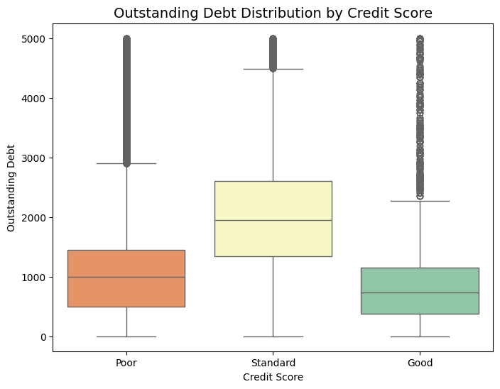
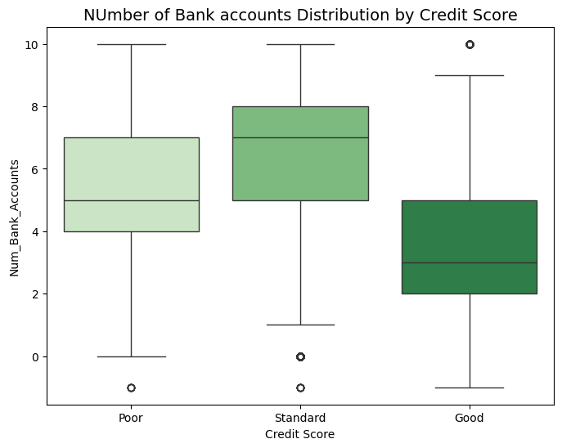
EDA: High-Risk Profile - Debt and Credit Utilization
Our analysis reveals that customers with different score groups show varying levels of leverage and debt.
Observation
Outstanding Debt: {r = 0.39} is lowest for the Good score group (median approx $750). The Standard group carries the highest median debt (approx $2,000), indicating the highest leverage among all customers.
The Number of Bank Accounts has a positive correlation ({r ~ 0.18} with a worse credit score. The Good score group has the lowest median number of bank accounts (approx 3), while the Standard group has the highest (approx 7).
Insight
Minimizing Outstanding Debt is a requirement for a Good credit score. Furthermore, a higher count of bank accounts suggests fragmented or complex financial management, which serves as an unexpected risk indicator for the Standard and Poor categories.

Slide 8
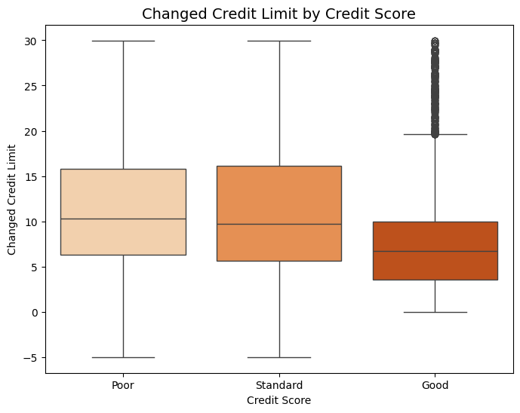
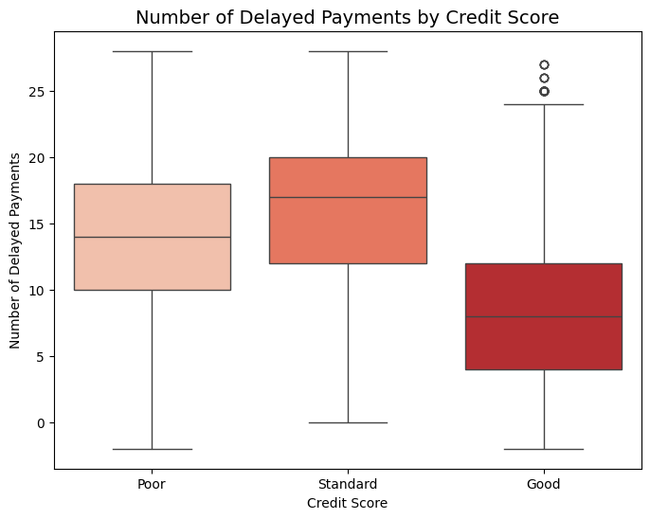
EDA: The Strongest Risk Factor - Payment Discipline
The primary characteristic separating Good credit from risk groups is payment history.
Aggressive Credit Seeking: A high Changed Credit Limit (r = 0.19) is a strong risk indicator, showing that customers in the Poor/Standard groups have a higher frequency of recent
credit limit changes.
Observation
Insight
Delayed Payments: The single strongest positive predictor of a Poor score is the Number of Delayed Payments (r = 0.20). The median number of delays for the Good score group (approx 8) is significantly lower than for the Poor/Standard groups.
Payment regularity is essential. Any increase in delayed payments is a
critical risk signal, strongly pushing the score towards the Poor category

Slide 9
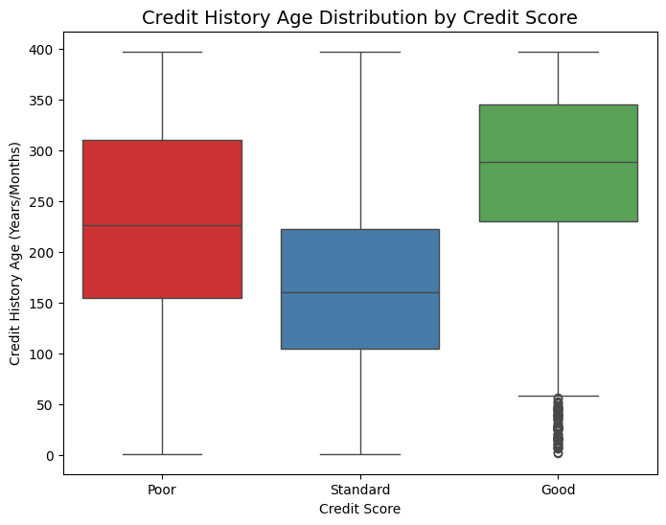
EDA: The Single Strongest Factor - Credit Longevity
The length of an individual's credit history plays a crucial role in determining their score
•Observation: Credit History Age (r = -0.61) is the single strongest numerical predictor of the target variable
Observation
The Good score group has a significantly higher median Credit_History_Age (approx 290) compared to all other groups.
Insight
A shorter credit history provides less data for lenders to assess long-term payment reliability. Credit longevity is the foundation upon which a Good credit score is built.

Slide 10
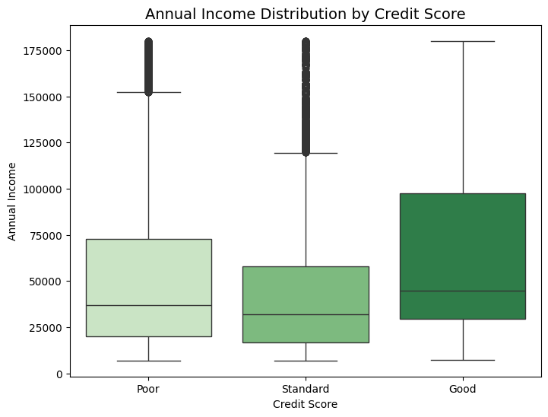
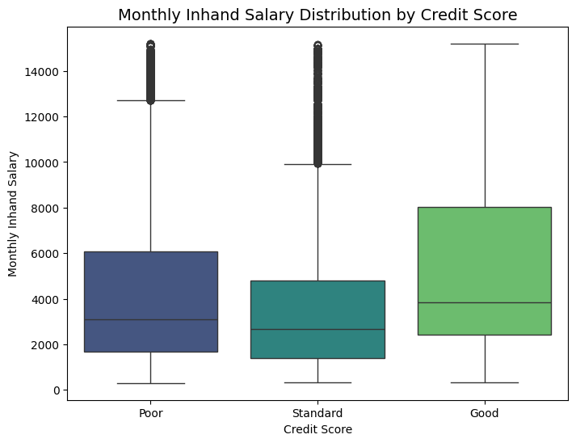
EDA: Protective Factor - Income and Financial Capacity
While financial behaviors are stronger predictors, occupation also provides valuable context
Annual Income (r = -0.08) and Monthly Inhand Salary are strong protective factors against a poor credit score.
Observation
Insight
The median Annual Income for the Good score group (approx 45,000$) is the highest, while the Standard group has the lowest median income (approx 30,000$).
This suggests that higher income provides the financial stability that strongly correlates with achieving and maintaining a Good credit score, making it a key contributing factor to overall financial health

Slide 11



Data Preprocessing Pipeline
We transformed the raw data into a machine-learning-ready format through two main phases:
Categorical Encoding
Train-Test Split
Label Encoding: Applied to the target variable Credit_Score. With 0 is ‘Good’, 1 is ‘Standard’ and 2 is ‘Poor’.
The encoded dataset was partitioned to ensure robust validation:
80% Training Set: Dedicated to model learning and optimization.
One-Hot Encoding: Used for nominal features (e.g., Occupation) to prevent the models from assuming incorrect orderings.
20% Testing Set: Reserved for final, unbiased performance evaluation on unseen data.

Slide 12

Six Classification Algorithms Implemented
We selected a comprehensive suite of classification models, ranging from linear to complex ensemble methods, to identify the optimal solution.
K-Nearest Neighbors (KNN)
Decision Tree Classifier
Random Forest Classifier
Gaussian Naive Bayes
XGBoost Classifier

Slide 13
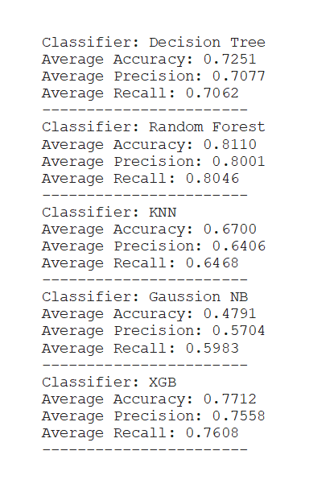
Model Performance Comparison
Evaluation metrics on the 20% test data highlight the superior performance of ensemble methods.
The Random Forest and XGBoost models achieved the highest accuracy, offering balanced predictive power across all metrics.

Slide 14
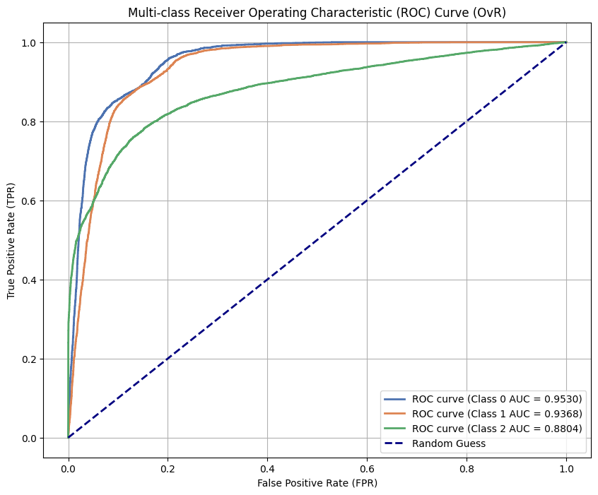
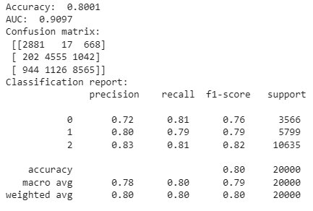
Deep Dive
Random Forest: Our Optimal Classifier
Performance Details
Reliable Classification Across Classes
The classification report confirms strong precision and recall for all three credit categories ('Good', 'Standard', and 'Poor').
The Random Forest Classifier, with an accuracy of 81.1%, demonstrates exceptional robustness. It utilizes an ensemble of decision trees to mitigate overfitting and maximize generalization.
High Diagonal Values: The confusion matrix (visualized on the left) shows high values on the diagonal, indicating the model correctly classified the vast majority of instances.
Minimal Error: Low off-diagonal values mean the model has minimal confusion between the 'Good', 'Standard', and 'Poor' credit scores.

Slide 15
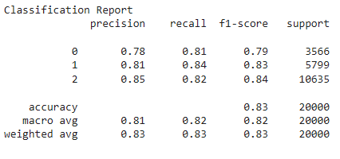
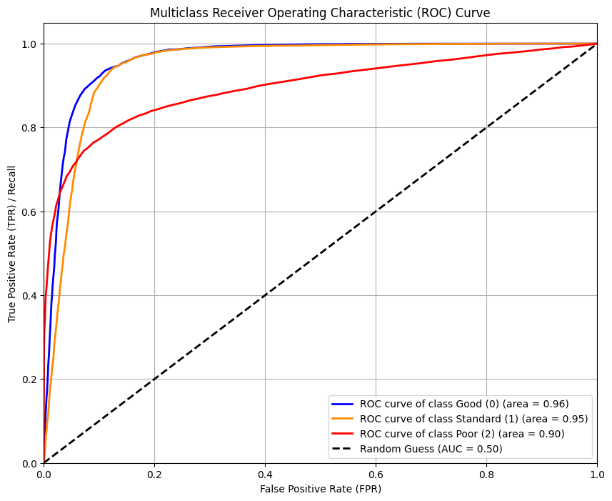
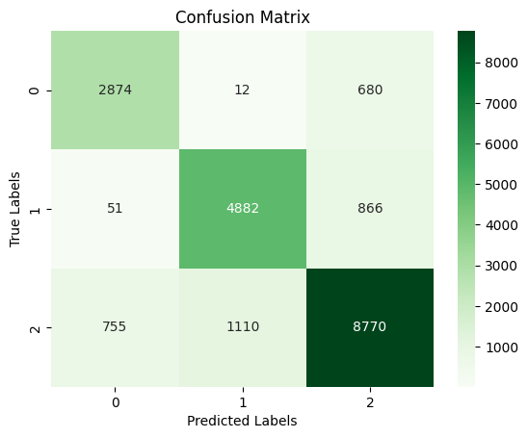
Deep Dive
Random Forest: More refinement
RandomizedSearchCV
Better model results
Utilize this optimization method to fine-tune the Random forest model.
The classification report confirms strong precision and recall for all three credit categories ('Good', 'Standard', and 'Poor').

Slide 16

Summary and Strategic Recommendations
Model Success
Key Features
The Random Forest Classifier is the proven top performer, achieving an accuracy of 83.05% in predicting credit scores.
• Key predictive characteristics of high-risk customers include high debt, aggressive credit seeking, and short credit histories.
Deployment Strategy
We recommend deploying the Random Forest model as an automated risk assessment tool, enhancing efficiency and standardization in lending decisions.

Slide 17
Summary and Strategic Recommendations
Key Insight | Predictive Factor | Lending Process Recommendation
Credit Longevity (r = -0.61) | Credit History Age is the strongest protective factor. | Implement a Minimum Credit Age Threshold: Require a strict minimum Credit History Age (e.g., 200+) for applicants seeking the highest tier loans or best interest rates. This immediately filters out the highest risk segment identified by the data.
Payment Discipline (r = 0.20) | Num_of_Delayed_Payment is the strongest active risk factor. | Establish an Auto-Decline Threshold: Set a low, hard limit for Num_of_Delayed_Payment (e.g., less than 5 in the last two years) above which the application is automatically flagged for manual review or decline. This addresses the most direct indicator of future default risk.
Financial Complexity (r approx 0.18) | High Num_Bank_Accounts is associated with risk. | Use Complexity as a Secondary Signal: For applicants scoring in the 'Standard' range, use a high Number of Bank Accounts as a secondary flag for caution, suggesting potential difficulties in managing fragmented finances.
Income as a Buffer (r approx -0.08) | Annual_Income is a strong protective factor. | Offer Tiered Rates: Use Annual_Income as a primary factor when determining interest rate tiers or loan amounts, rewarding higher-income individuals who demonstrate the financial capacity to absorb risk, even if other factors are marginal.

Slide 18

Thank You.
We have successfully validated a reliable machine learning model for automated credit score classification.
Questions & Discussion

